Slide 1
Photography Exit Survey
Write out your answers and bring to next class.
Photo 1-7 Discuss the problems with shooting the image presented. What would you do to prepare to shoot these images?
How would you as a photographer go about shooting this image? What might the exposure settings be (generalizations are ok, but more specific is better).

Slide 2
Question #1

Slide 3
Question #2

Slide 4
Question #3

Slide 5
Question #4

Slide 6
Question #5

Slide 7
Question #6

Slide 8
Question #7

Slide 9
Question #8 What type of lens was used for this shot? What problems would you need to be ready for?

Slide 10
Question #9 What type of lenses were used for each of these shots? And how do you know? What traits tell you about the lenses? (hint: neither uses normal focal length).

Slide 11
Question #10 What is this effect called and how is it made?

Slide 12
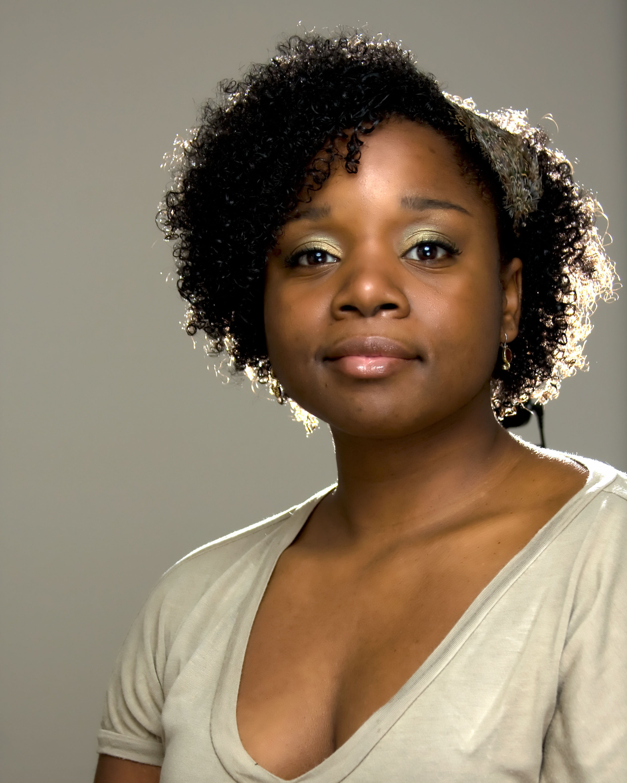
Question #11
For each image, describe the number of lights, their location, and any other information you can gather from the photo.
Sketch or Diagram the location of the subject, lights, and photographer in the diagram.

Slide 13
Question #11

Slide 14
Question #12

Slide 15
Question #13a Use the chart shown to answer the following questions. Your photograph is green overall. What white balance setting should you choose to correct this?

Slide 16
Question #13b Use the chart shown to answer the following questions. Your photograph is yellow overall. What white balance setting should you choose to correct this?

Slide 17
Question #13c Use the chart shown to answer the following questions. Your photograph is blue overall. What white balance setting should you choose to correct this?

Slide 18
Question #14 A) What is the color model for each of the diagrams on the left and right? B) One is additive and one is subtractive. Which is which? C) One is used for digital media and one is used for print. Which is which?

